Slide 1

Lecture5
Secant and Newton Raphson

Slide 2
Open Methods
For the bracketing methods, as discussed in previous lectures, the root is located within an interval prescribed by a lower and an upper bound
Repeated application of these methods always results in closer estimates of the true value of the root
Such methods are said to be convergent because they move closer to the root as the computation progresses
In contrast open methods require only a single starting value of x or two starting values that do not necessarily bracket the root

Slide 3
Open Methods
They sometimes diverge or move away from the true root as the computation progresses
when the open methods converge they usually do so much more quickly than the bracketing methods

Slide 4
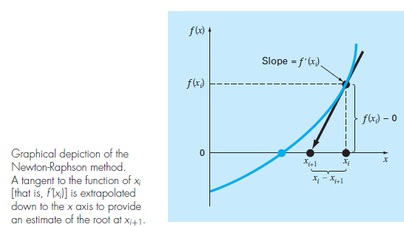
NEWTON-RAPHSON METHOD

Slide 5
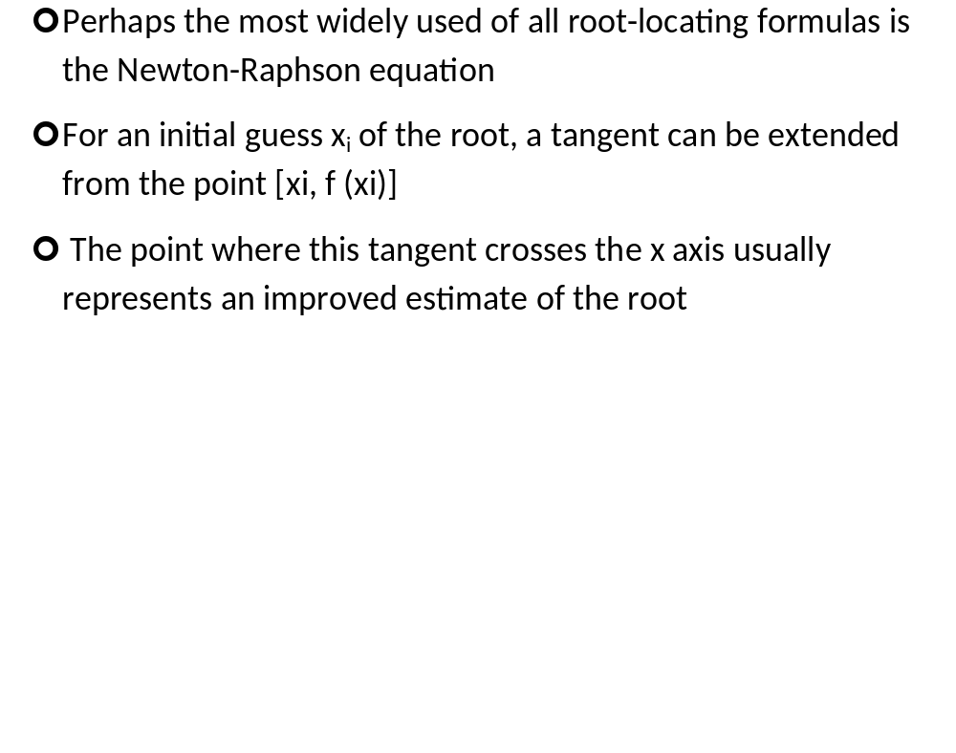
NEWTON-RAPHSON METHOD

Slide 6
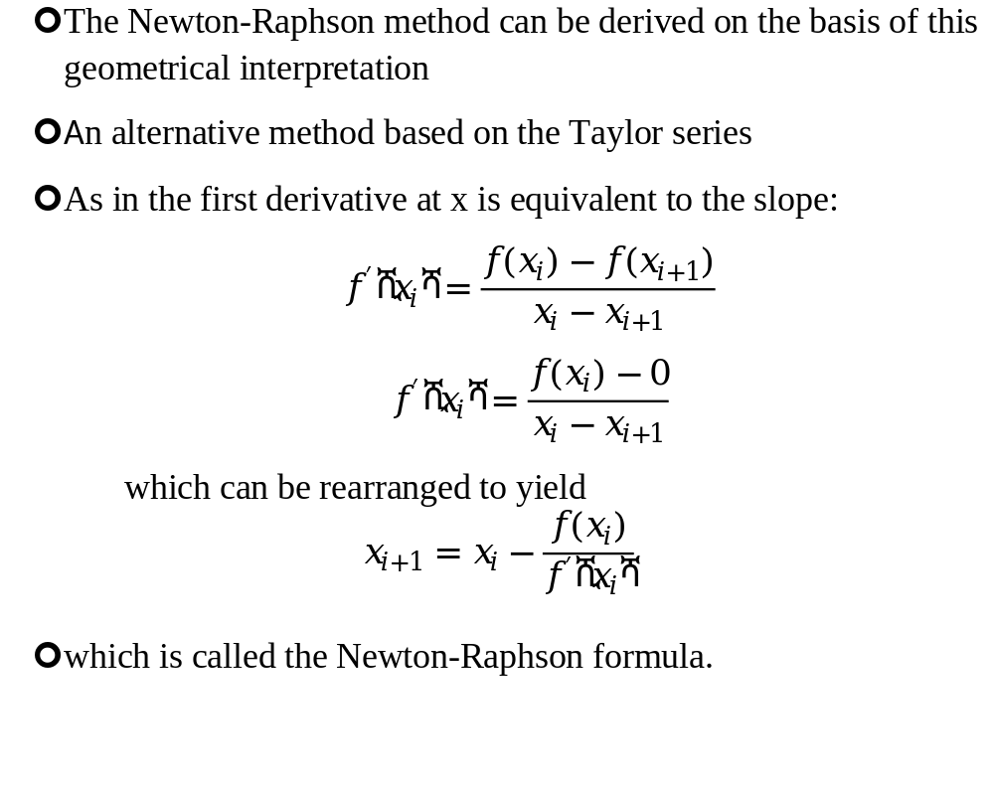
NEWTON-RAPHSON METHOD

Slide 7
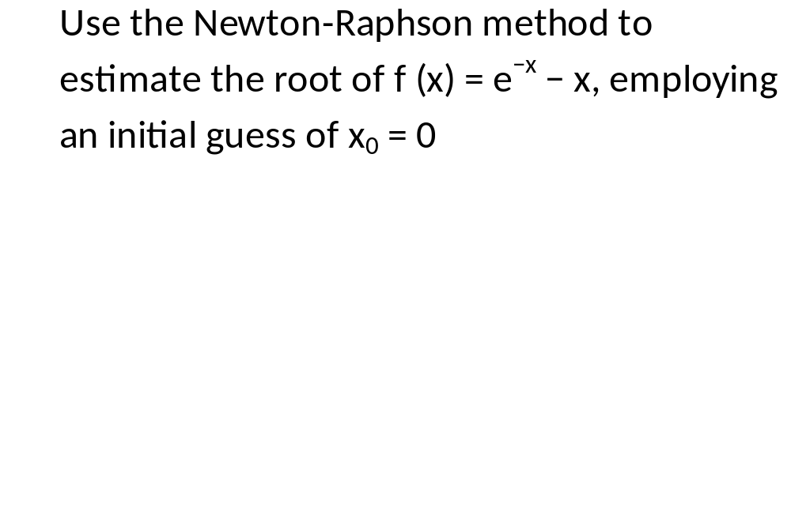
Exercise

Slide 8
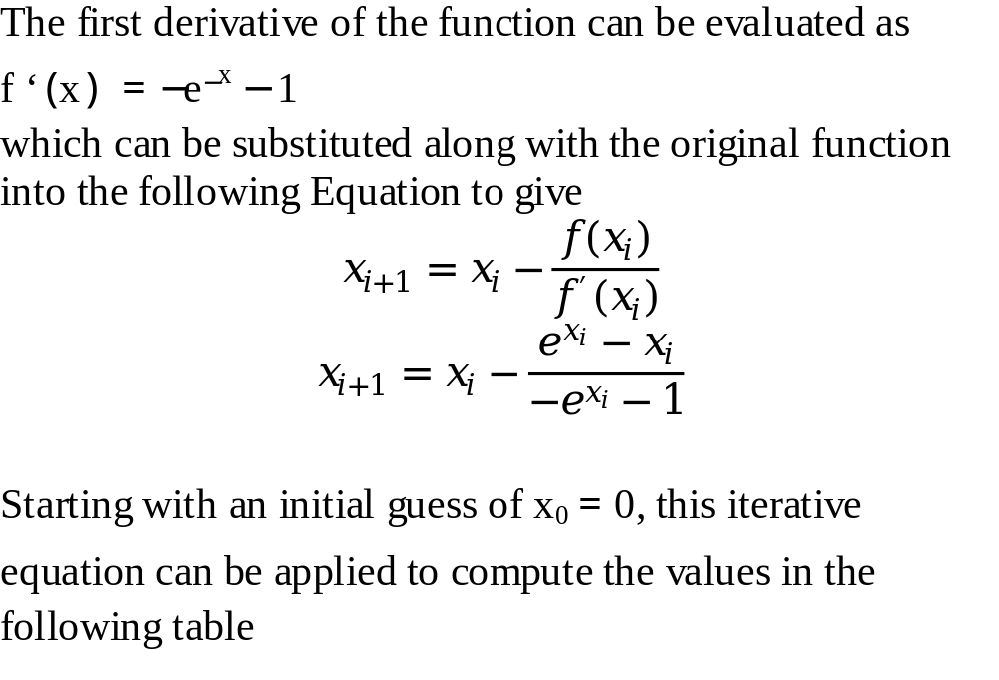
Solution

Slide 9
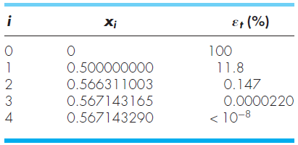
Solution Cont.

Slide 10
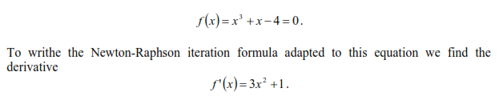

Slide 11
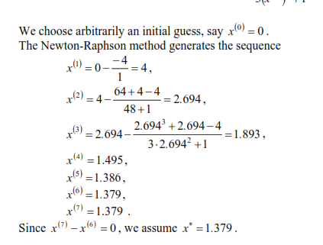

Slide 12
Pitfalls of the Newton-Raphson Method
Although the Newton-Raphson method is often very efficient, there are situations where it performs poorly
Besides performing poorly in case of multiple roots difficulties can also arise even when dealing with simple roots

Slide 13
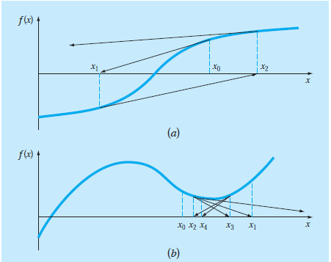
Pitfalls of the Newton-Raphson Method
Fig. a depicts the case where an inflection point [that is, f (x) = 0] occurs in the vicinity of a root and figure b illustrates the tendency of the Newton-Raphson technique to oscillate around a local maximum or minimum

Slide 14
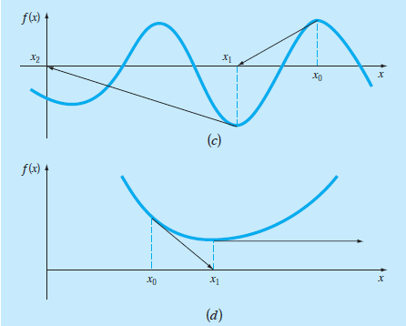
Pitfalls of the Newton-Raphson Method
Figure c shows how an initial guess that is close to one root can jump to a location several roots away and Fig. d shows a zero slope case

Slide 15
Algorithm for Newton-Raphson
An algorithm for the Newton-Raphson method is readily obtained by using Newton-Raphson Formula that we derived
The computer program must compute the first derivative
This can be simply accomplished by the inclusion of a user-defined function

Slide 16
Algorithm for Newton-Raphson
The program would be improved by incorporating several additional features:
  A plotting routine should be included in the program
  At the end of the computation, the final root estimate should always be substituted into the original function to compute whether the result is close to zero. This check partially guards against those cases where slow or oscillating convergence may lead to a small value of ε_{a} while the solution is still far from a root.

Slide 17
Algorithm for Newton-Raphson
  The program should always include an upper limit on the number of iterations to guard against oscillating, slowly convergent, or divergent solutions that could persist interminably.
  The program should alert the user and take account of the possibility that f’(x) might equal zero at any time during the computation.

Slide 18
THE SECANT METHOD
A potential problem in implementing the Newton-Raphson method is the evaluation of the derivative
Although this is not inconvenient for polynomials and many other functions, there are certain functions whose derivatives may be extremely difficult or inconvenient to evaluate

Slide 19
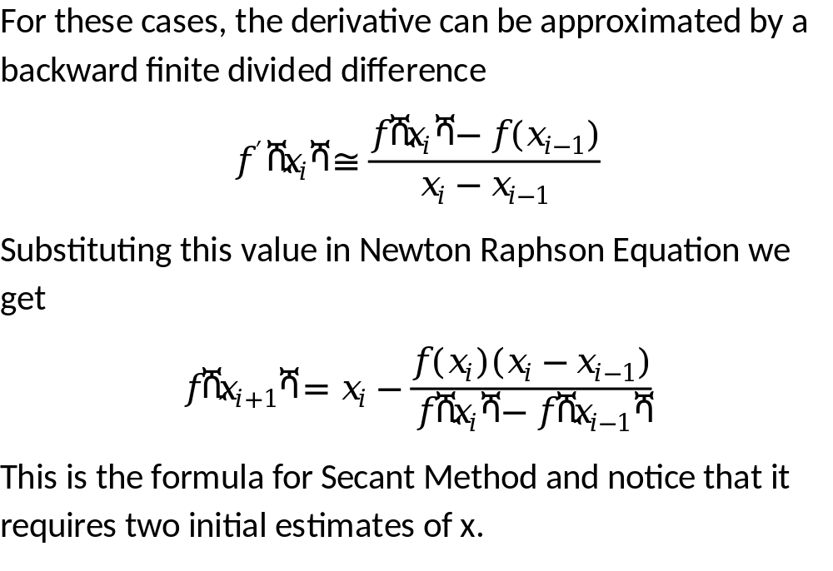
THE SECANT METHOD

Slide 20
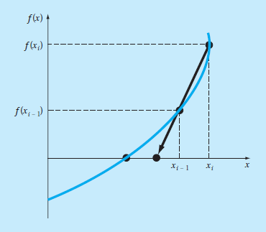
Graphical Depiction of Secant Method

Slide 21
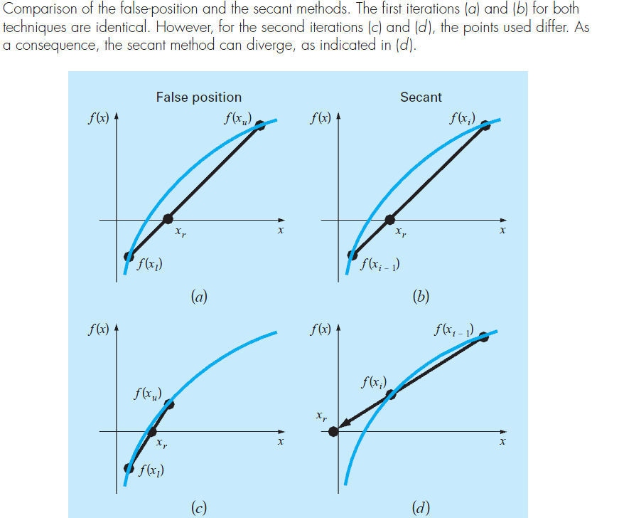
The Difference Between the Secant and False-Position Methods
.

Slide 22
The secant method applied to f(x) = cos(x) + 2 sin(x) + x².
n x_{n − 1} x_{n} x_{n + 1} |f(x_{n + 1})| |x_{n + 1} - x_{n}|
1 0.0 -0.1 -0.5136 0.1522 0.4136
2 -0.1 -0.5136 -0.6100 0.0457 0.0964
3 -0.5136 -0.6100 -0.6514 0.0065 0.0414
4 -0.6100 -0.6514 -0.6582 0.0013 0.0068
5 -0.6514 -0.6582 -0.6598 0.0006 0.0016
6 -0.6582 -0.6598 -0.6595 0.0002 0.0003

Slide 23


